Slide 1


Total Joint Replacement Patient Education Kat Hunt, RN, BSN Orthopedic Nurse Navigator

Slide 2
Agenda
Preparing for Surgery
What to expect Day of Surgery
Expectations for Recovery
Preventing Complications

Slide 3
Your Joint Replacement Team
Orthopedic Surgeon
Physician Assistant
Nurse Navigator
Medical Assistant
Hospital Staff
Physical/Occupational Therapist
Support Person/Coach

Slide 4

Preparing for Surgery

Slide 5
Preparing for Surgery
FMLA or Employer/Assistance Paperwork
Drop off or fax to Deer Lodge Medical Center Clinic
Ortho fax: (406)-846-4784
Insurance Authorization
Prior-authorization team at DLMC
Will contact you if no-go
Questions: patient Financial Services: (406) 846-7735

Slide 6
Preparing for Surgery
Orthopedic Nurse Navigator (406) 299-9144
Will:
call when you are scheduled for surgery
make sure you have completed your pre-op clearances
follow-up with you 1 week post-op & 30 days post-op

Slide 7
Preparing for Surgery
Medical Clearance with Your Primary Care Provider
Referral to your PCP sent by us if needed
form in your packet for them to fill out and fax back to us
You make appointment
2-4 weeks in advance of surgery
If not completed by 2 weeks from surgery…you will be rescheduled!
Exam includes:
Physical exam and interview
EKG (if indicated)
Labs & MRSA/MSSA testing
Referral to specialties and/or additional testing

Slide 8
Preparing for Surgery
Hematology Clearance
History of blood clots, blood disorder, stroke, or strong family history
Already see a hematologist for a medical condition
Other Specialty Providers
Already see a specialty doctor, we will let you know if we require a surgical clearance from them
(cardiology, endocrinology, pulmonology, etc.)
If your PCP or our team feels you need to bee seen by specialty provider, you will be notified and send the referral on your behalf

Slide 9
Preparing for Surgery
Pre-op Dental Exam
Schedule if:
Not seen within last 3 months for cleaning and/or exam
Experiencing any dental discomfort
Cavity filling, replacing crown, etc. does not qualify as “dental exam”
Must get regular cleanings and yearly exams/x-rays
If you don’t obtain dental clearance, our surgery will be postponed…No exceptions!
Why?
Protects against joint infection
Bad oral health– one of the most common sources for late total joint infection

Slide 10
Preparing for Surgery
Obtain Durable Medical Equipment (DME)…Walmart/Amazon
Front-wheel walker
Raised toilet seat
Shower chair
Schedule Physical/Occupational Therapy (knee only)
1st apt within 48 hours following surgery
Physical/Occupational Therapy prescription with protocol in your packet
You schedule your apt

Slide 11
Preparing for Surgery
Home Medications
Stop all herbal medications & supplements 7 days prior to surgery (St. John’s wort, echinacea, ginkgo, ginseng, ginger, licorice, garlic, valerian, multivitamin, vitamins C, D E, magnesium calcium, etc.)
Stop all medications that increase bleeding 5 days prior to surgery unless instructed otherwise (aspirin, Motrin, naproxen, ibuprofen, Advil, Aleve)
You may continue Celebrex (celecoxib) up until the morning of surgery
If you take a blood thinner such as Warfarin, Eliquis, Xarelto, Pradaxa, etc., you will need special instructions for stopping this medication, Typically, these are stopped 3-5 days prior to surgery. Get clear instructions on stopping these medications from the prescriber.
The pre-op nurse will provide instructions on how to discontinue use of other medications. If you have any questions regarding medication use prior to surgery, contact your Nurse Navigator.

Slide 12

Preparing for Surgery
Pick up Post-op Medications
Rx’s will be available at your pharmacy 1-2 business days prior to surgery
Medications cannot be sent until we have received all your medical clearances
Medications you will receive
Oxycodone and/or hydrocodone…pain
Celebrex…pain & inflammation
Hydroxyzine…nausea, itching, restlessness
Stool softener (over-the-counter)…constipation
Anticoagulant (based on your medical needs)…prevent blood clots
Antibiotics…prevent infection

Slide 13

Preparing for Surgery
Day/Night Before Surgery
You will receive a call from the hospital with your check-in time by 3 pm the business day before
Do not eat after midnight!
You may drink clear liquids up to 2 hours prior to check-in
Water, Gatorade (not red, blue, or purple), black coffee/tea…NO CREAMER/DAIRY/SUGAR!
Do not smoke/vape or use any tobacco/nicotine products after midnight
Shower and follow instructions for chlorhexidine wipe skin prep tonight
Sleep in clean PJ’s & bedding
Remove artificial nails, polish, and jewelry/piercings
Follow all instructions given to you by the hospital

Slide 14
Preparing for Surgery
What to bring:
Photo ID & insurance card(s)
Advance directive & any legal documents
List of home medications
Inhaler (if applicable)
Glasses, dentures, hearing aids with cases
CPAP(if applicable)
Comfortable, loose clothing
Well-fitted, flat, non-slip shoes
Front-wheel walker
Support person/coach

Slide 15

Day of Surgery

Slide 16
Day of Surgery
Pre-op
Park in the back of the hospital near the ER entrance
You will be escorted to the pre-op area
Pre-op nurse will get you ready for surgery
Anesthesia interview, instructions, and consents
Nerve block performed…knee only
Surgeon and/or assistant will have you sign consent for surgery, mark your surgical site, and answer any final questions
OR nurse will perform interview & bring you to the surgical suite
Support person/coach will be escorted to waiting area & be contacted when your surgery is over

Slide 17

Day of Surgery
Surgical Procedure
Once you arrive in the operating room, the team will get you prepped for surgery
Spinal anesthesia placed
Vitals and IV medications
Body positioning & skin prep
Draping of surgical site
Time-out preformed
Once dressing is applied and vitals are stable you are transferred to the post-op area
Total time in the OR can average 2 hours

Slide 18
Day of Surgery
Post-op
OR nurse and anesthesia transfer you to the PACU and your post-op nurse
Monitor vital signs, wake up from anesthesia, control pain
Rehab will see you
X-ray may be taken (hips only)
You will be discharged home when…
Pain is under control
Can urinate
No Nausea/Vomiting
Can perform PT/OT
Given & understand all your discharge instructions
Prepare to be at the hospital a minimum of 6-8 hours

Slide 19

Recovering After Surgery

Slide 20
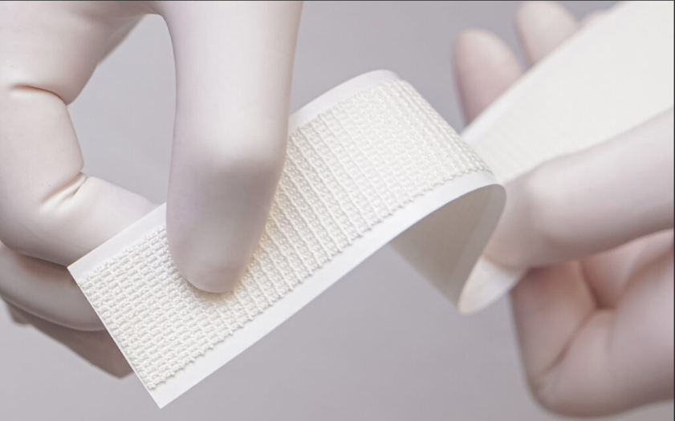

Recovering After Surgery
Partial/ Total Knee
ACE bandage & gauze padding …remove 48 hours post-op
Total Hip
Mepilex dressing…remove 10 days post-op
Sylke adhesive dressing…remove at 2-week post-op appointment
Sylke adhesive dressing…remove at 2-week post-op appointment
Mepilex dressing…remove 10 days post-op

Slide 21
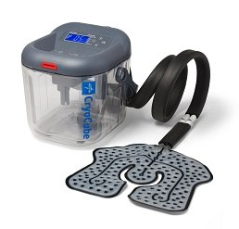
Recovering After Surgery
Post-op Equipment
Cold Therapy System
Filled with ice and water
Continuously circulates cold water to a wrap around the affected knee

Slide 22
Recovery After Surgery
/
Do not remove dressings before instructed to do so
Keep dressings covered when showering
Do not submerge incision in bath, hot tub, swimming pool until completely healed (3-4 weeks)
Do not apply lotions/ointments/creams to incision until healed
Notifiy provider if any drainage, odor, redness, increased pain along incision, fever, chills, sweating

Slide 23
Recovery After Surgery
Common Findings
Pain & Swelling
Take your pain medication as prescribed ON SCHEDULE
Set your alarm & don’t skip doses at night
Change positions frequently
Post-op day 2-5 are often the hardest
Use ice or cold therapy
At least 4 x per day for 20-30 minutes for the first 48 hours
After PT/OT & physical activity
Swelling may not show up for a few days & can last a few months
Elevate above the heart
Refill requests are required 48 hours in advance…so don’t wait until you’re completely out to request!!

Slide 24
Recovery After Surgery
Common Findings
Bruising
Can appear anywhere on the affected limb
May not appear for several days after
Constipation
Common side effect of opioid medications
Take stool softeners
Increase liquids and fiber
Can use OTC laxatives if necessary, but sparingly
Contact provider if experiencing abdominal pain
Decreased Appetite
Drink lots of fluids to avoid dehydration
Eat small bites of food with medication
Difficulty Sleeping
May last a month or more
Take pain medications through the night…don’t skip doses
Work with PT/OT for comfortable positioning

Slide 25

Recovering After Surgery
Appropriate Activity
Exercise/physical activities
Discuss with surgeon and PT/OT before returning to any specific activities
Need to be seen for 2-week post-op prior to beginning anything other than PT/OT, prescribed home exercises, walking
When can I drive?...Directed by your surgeon, but usually…
Left hip/knee
Off narcotics & can safely get yourself in and out of vehicles
Right hip/knee
Off narcotics, 2-week post-op, and can move foot between pedals and press firmly on the break with appropriate reaction time
When can I fly?
Do not travel until you have been seen for your 6-week post-op appointment and the surgeon gives you clearance

Slide 26

Preventing Complications

Slide 27
Preventing Complications
Infection
Follow instructions for wound care & notify provider with any concerns
Drainage, odor, increased redness/pain along incision, fever >100.4, nausea/vomiting, chills, sweats
Rash, hives, blisters, etc.
No dental work for 3 months following surgery unless emergent
Antibiotic therapy prior to any dental procedure for following 2 years

Slide 28
Preventing Complications
Blood clot
Notify provider if you develop
Sudden swelling in the thigh/calf/ankle/arm on either side that does not go away with elevation
Increased pain, heat, tenderness to back of knee/calf/ groin/underarm
Pulmonary embolism (clot in lung)
Life threatening emergency!
Call 911 if you develop
Sudden onset of shortness of breath, chest pain, sweating, confusion/agitation
How to prevent
Wear compression stockings for 6 weeks
Take anticoagulation medication as prescribed
Ambulate every hour for 10 minutes during waking hours
Drink plenty of fluids

Slide 29
Contact Information
DLMC Clinic
(406) 846-1722
DLMC Hospital
(406) 846-2212
Orthopedic Nurse Navigator
(406) 299-9144
khunt@dlmed.org

Slide 30

Thank You

